Slide 1
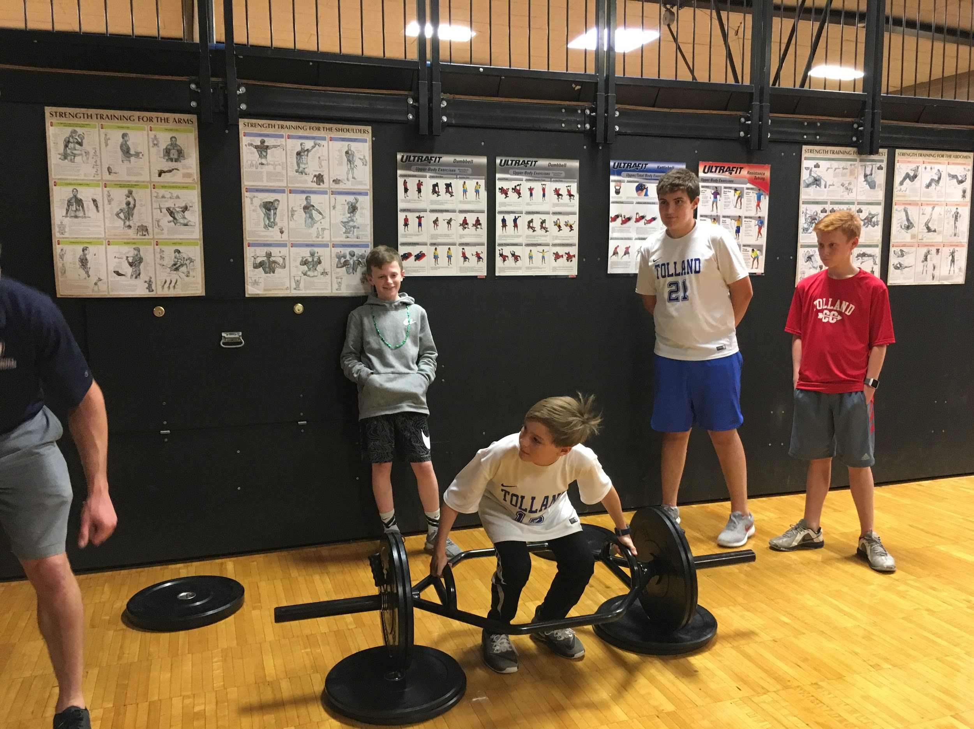
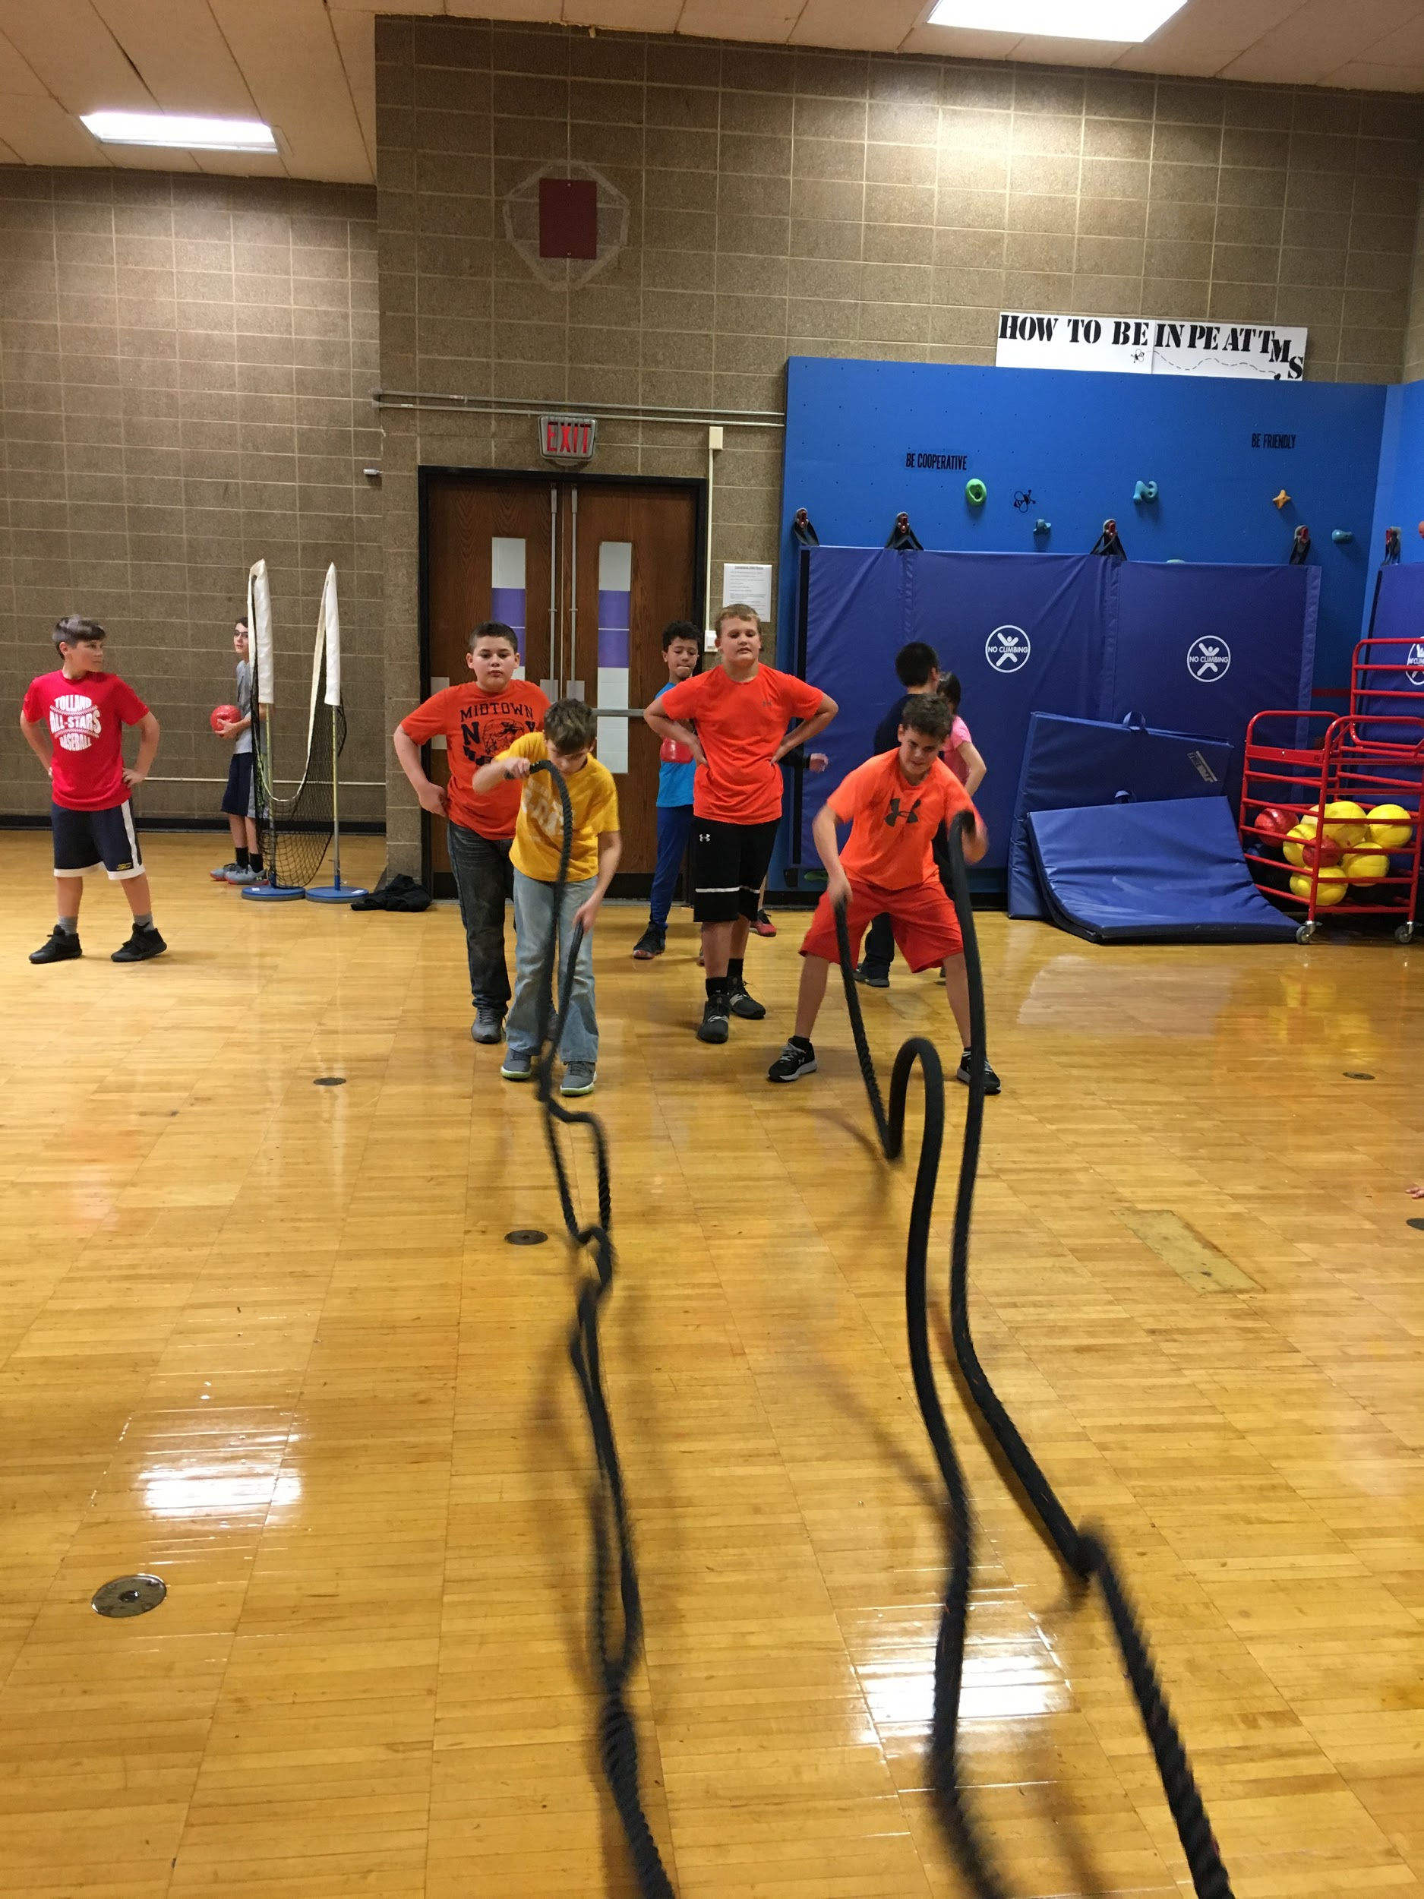
TMS
Performance Training Lab

Slide 2
Who?
For the serious and motivated athletes at TMS
What?
Athletes will train for strength, speed, power, and/or agility. They will keep track of their data after several assessments. The data will drive the programming.

Slide 3
Why?
Athletes who want to to take their sports performance to the next level and soar above the rest.

Slide 4
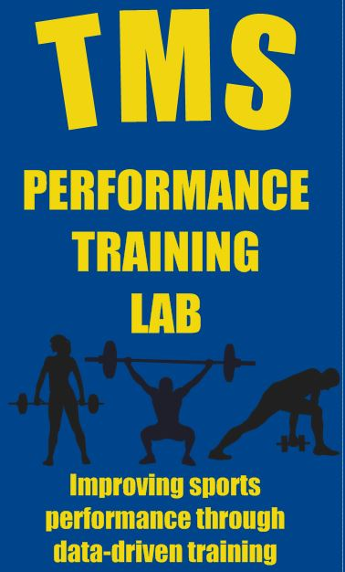
Where?
Training Lab is located in the mini gym
When?
During Xblock on Wednesdays from 1:30 p.m. to 2:30 p.m. and some PE 2 classes.
Notes:
Athletes must commit to the 8 week cycle in order to see the most results.

Slide 5
How?
How?
Sign up by applying on Monday morning in homeroom for the first 8 week cycle. Only 20 spots are available for the first session.
Notes:
You will be notified by email by Wednesday, Nov. 28 if you have been selected to be a part of the first 8 week session.

Slide 6
Possible Physical Assessments
Categories | Assessments in each category
Speed | 30m Sprint, 40 Yard Dash
Agility | 5-10-5 Pro Agility
Power | Timed 10 Jump Drop Test, Reactive Strength Index, Vertical Jump, Approach Jump, Broad Jump
Strength | Max Reps Push Ups, Max Reps Pull Ups, Max Reps 2 Kettlebell Squat, 10 Rep Max Trap Bar Deadlift
Cardiovascular | Mile Run, PACER Test, Modified Wingate Test on a spin bike

Slide 7
Special Shout Out to CT Sport and Fitness
Thank you for collaborating with the TMS PE Dept.

